Slide 1




Comprehensive AI Architecture to Monitor and Predict Heart Rate during Physical Exercises
Team
Talia brooks
Aaron Bemis
Jack Morris
Alex Boyett
Lauren Bailey
Milestone 1 Report
IT Capstone 4983
Kennesaw State University
September 25th, 2022

Slide 2
Contents
I. Introduction
II. Team
III. Contents
IV. Summary
V. Milestone Assessment
VI. Project challenges
VII. Gantt chart
VIII. Future plan

Slide 3
Summary
Gathering and editing all data for the project
Designing programs to run through the data
Assigning work and communications to everyone.
Geographical data being broken down into certain values such as city, state and zipcode.
Weather data being broken down into certain values such as, temperature, humidity and precipitation
Revaluating programs to attempt to make the data run smoother
Setting up logins for the server and understanding how to access Jupyter for housing programs and data.

Slide 4
Summary
• In Progress A trained deep learning architecture that utilizes the person's information during exercises as well as environmental information to monitor and predict heart rates.
• Complete Milestone 1: A comprehensive dataset on heart rate during exercises with geo data: longitude, latitude, altitude and weather
data: temperature, humidity, precipitation. (at least 1000)
• In Progress Milestone 2: A construction of deep learning models based on generated data from milestone 1.
• In Progress Milestone 3: Tested and finetuned deep learning models from milestone 2.
• In Progress Milestone 3: Comparisons with other state-of-the-art methods in terms of accuracy.
• In Progress Complete Source code and documentation
• In Progress Final Peer evaluation
• In Progress Individual performance reflection
• In Progress Progress reports
• In Progress Video Presentation
• In Progress References/Tutorials/Manuals
• In Progress Final Research Report
• In Progress Survey
• In Progress Capstone website showcase
• In Progress Department presentation

Slide 5
Milestone 1 objectives
I. Pull in Endomondo data (Raw) and combine it with geographical data and weather data.
II. Clean that data and prepare it for modeling.
(must have at least 1000)

Slide 6
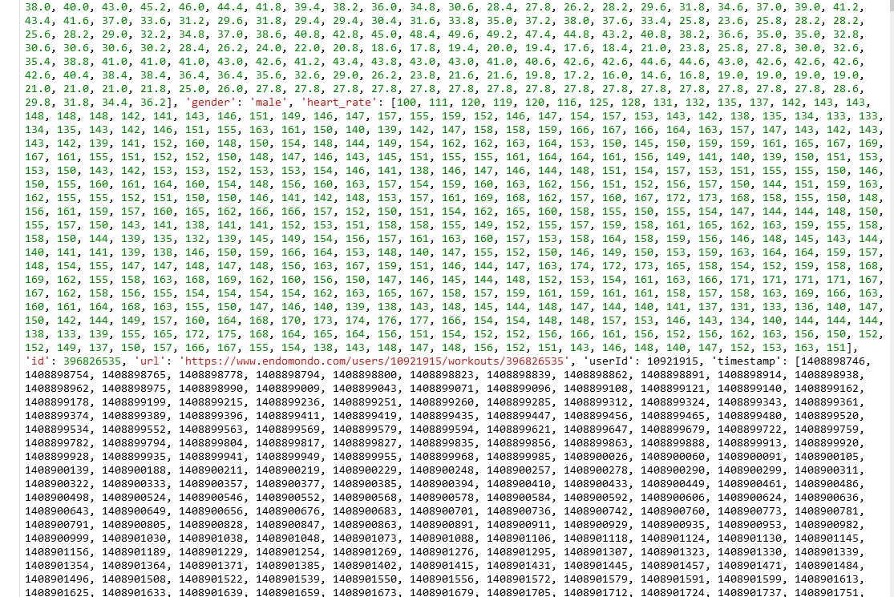
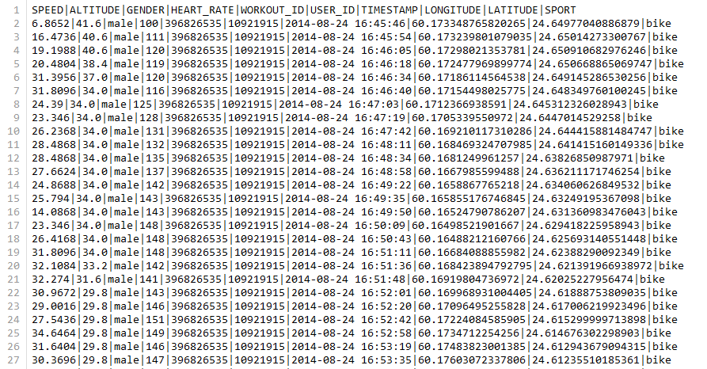
Milestone 1 objective I Raw Data
Dealing with the raw data meant taking all the data points found in a single row of data and splitting those out line by line. Each exercise can have up to 500 geographical coordinates, heart rate measurements, movement speed etc. Those 500 points of data translated to 500 lines of data for each exercise. We chose to do a pipe | delimited file that could then be used to assemble a dataset for the final deliverable for Milestone 1.

Slide 7
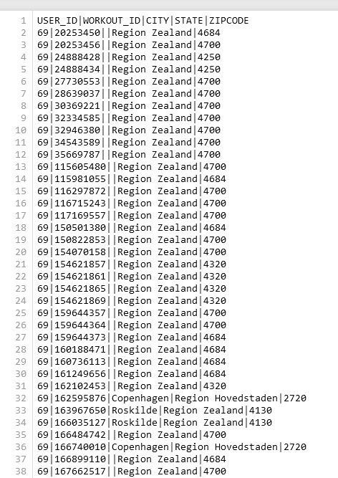
Milestone 1 objective I Geographical Data
For the collection of geographical data, we took the raw dataset, looked up city, state and zip code of the activity based on the provided latitude and longitude coordinates. The API called Nominatim for looking up this data has some limitations that ultimately led us to running parallel processes around the clock in order to obtain all the data we needed for this portion of the Milestone 1 requirement. Just like the raw data, we collected this into a single pipe delimited file for merging in our final step.

Slide 8
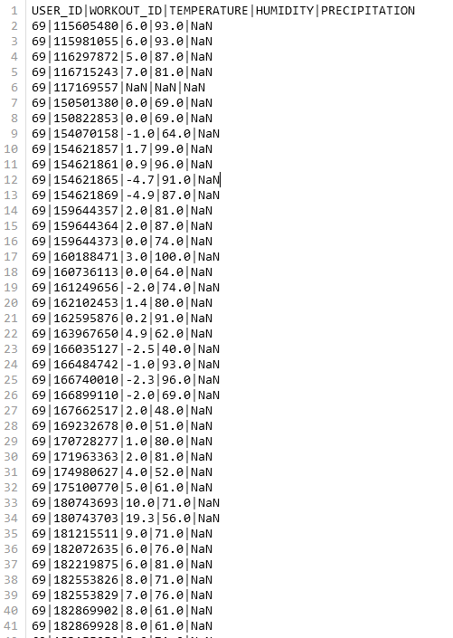
Milestone 1 objective I Weather Data
Weather data was obtained in a similar way as the geographical data. There were far less API restrictions for this data so acquiring it was much quicker. For this data, we would send the timestamp, latitude and longitude coordinates of the activity to the API meteostat and record the returned temperature, humidity and precipitation for that area for the hour of the timestamp. Once again, this was all captured in a single pipe delimited dataset for merging with the raw data.

Slide 9

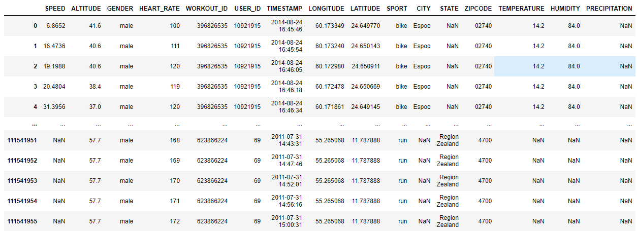
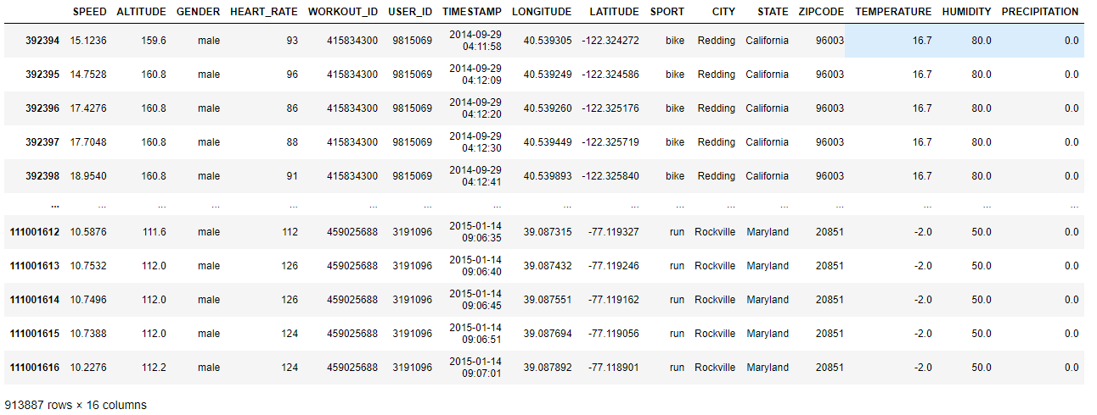
Milestone 1 objective II Clean the data and prepare it for modeling.
Endomondo raw data, geographical data, and weather data combined in a table (and .csv).
Prepared through Jupyter Notebook using Pandas and Numpy.
Below: 1539 unique workouts with 500 data points no NaN, ready to be used.

Slide 10
Project Challenges
Original plan
Deviation
Collect weather data and geographical data for every single coordinate and timestamp.
Write API calls to lookup the needed data points.
Use a table in a database to build out the final dataset.
We learned that the geographical API has restrictions of only several thousand requests a day and a limit of no more than one request per second.
These restrictions, with permission of our sponsor, lead us to pulling a single geographical coordinate and checking the weather elements every hour for an exercise.
A sponsor meeting helped us understand the databases and tables were not necessary for the final deliverable but proved to be valuable when checking some of the data.

Slide 11
Challenges continued...
Pros
Cons
Challenges
All of us are able to work anywhere due to being online
Open communication using email, teams and GroupMe.
Quick response times from the team.
Break out group meetings happen frequently each week.
Professor Le has been wonderful to work with. He is very responsive to email and is helpful in sponsor meetings.
Very different schedules, hard for the entire team meeting up
API limitations when trying to extract so much data
Assigning roles and figuring out who fits what
Certain programs were taking so long to run that was easier for a single person to run them and report back to the team.

Slide 12
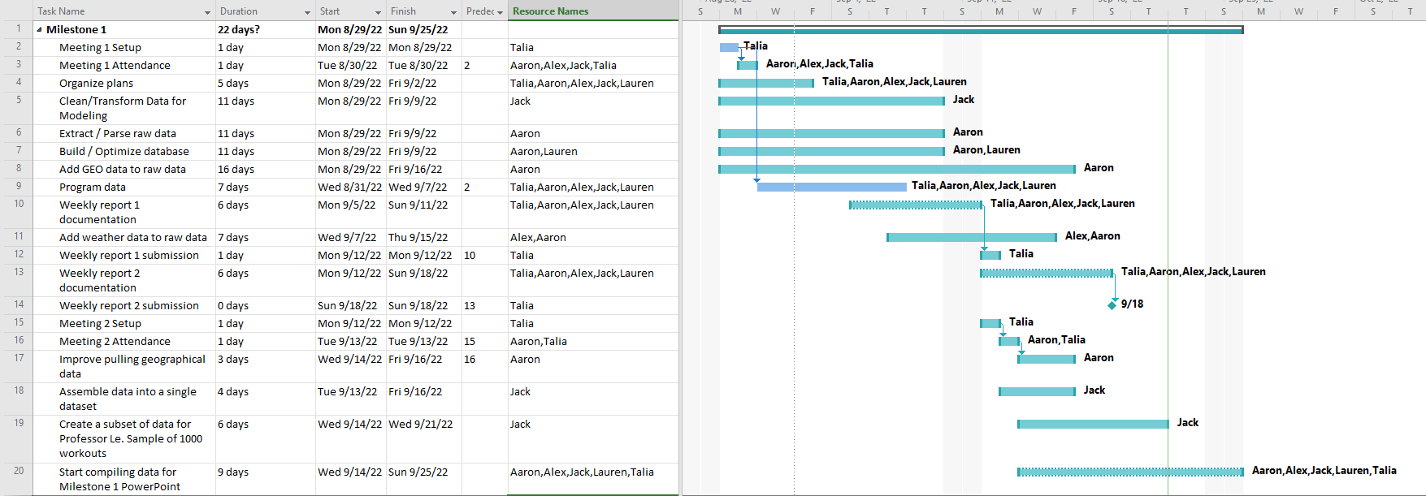
Gantt chart for Milestone 1

Slide 13

Next phase
Currently on track to the clean the rest of the data for Milestone 1. Milestone 2 initial modeling and working with the professor to develop these learning models using all data currently extracted models based on this information.

Slide 14
References
Jianmo Ni, Larry Muhlstein, Julian McAuley, "Modeling heart rate and activity data for personalized fitness recommendation", in Proc. of the 2019 World Wide Web Conference (WWW'19), San Francisco, US, May. 2019.
FitRec-project. FitRec-Project. (n.d.). Retrieved September 22, 2022, from https://sites.google.com/eng.ucsd.edu/fitrec-project/home‌
“Nominatim.” Nominatim.org, nominatim.org/.
“The Weather’s Record Keeper.” Meteostat, meteostat.net/en/.
Pandas. “Python Data Analysis Library — Pandas: Python Data Analysis Library.” Pydata.org, 2018, pandas.pydata.org/.
Jupyter Project Documentation#. Jupyter Project Documentation - Jupyter Documentation 4.1.1 alpha documentation. (n.d.). Retrieved September 22, 2022, from https://docs.jupyter.org/en/latest/

